Slide 1

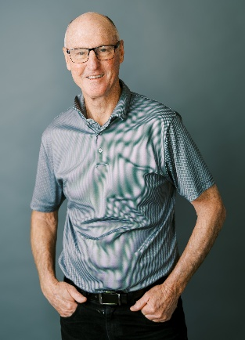
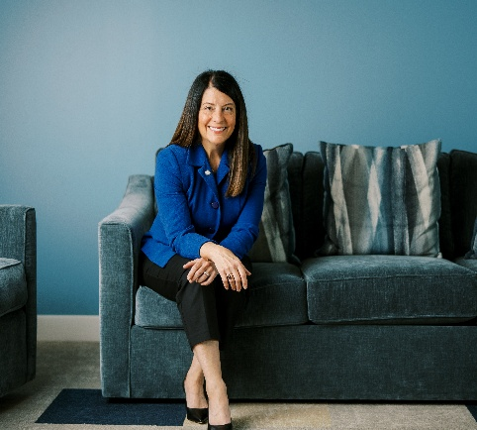
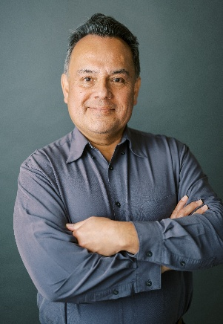

Dave
Louise
Greg
Your fellow parishioners invite you to
Grow in Spirituality by serving
Neighbors in Need
Join our ministry at St. Brigid!
  We work in pairs, visiting neighbors in their homes to listen and help them through tough moments.
  We keep neighbors housed by offering emergency bill assistance for rent, utilities, transportation, medical care and more.
  We keep a food pantry stocked and ready for neighbors in need.
  We organize semi-annual food & clothing drives at St. Brigid.
  We cook & serve meals at nearby churches for homeless families in the Family Promise program.
  Other ways to help: helpline intake calls, fundraising, communications, social gatherings, and a range of administrative duties
Meetings: First Saturdays (8 a.m.) & Third Tuesdays (7 p.m.)
Brian Chilla (Membership) brian.svdp.stbrigid@gmail.com
Peter Psyhogios (President) peter.svdp.stbrigid@gmail.com

